Slide 1
Bayesian Analysis Credit Card Fraud Detection
Sony Nghiem
04/20/2017

Slide 2
Outline
Data & Questions
Probit Model (MCMC)
Naïve Bayes Method
Results
Conclusion

Slide 3
Data
European credit card transactions within two days in September, 2013
284,807 transactions, of which 492 are detected frauds
One class binary (0 and 1) variable and 30 features (Time in seconds and Amount (not clear in unit measurement), and 28 numerical variables)
Descriptive Statistics [Link]

Slide 4
Questions
Which models are appropriate for classifying this dataset? (normal vs fraud)
Among different statistical models that I might build, which one performs better?

Slide 5
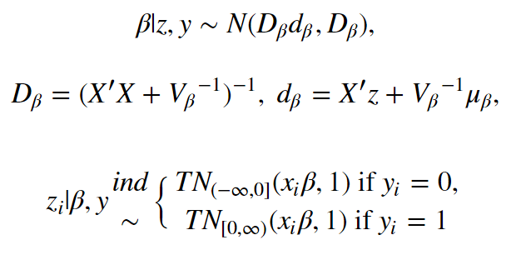
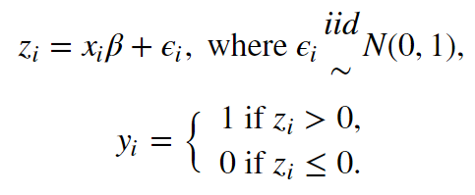
Probit Model (Gibbs Sampling)

Slide 6
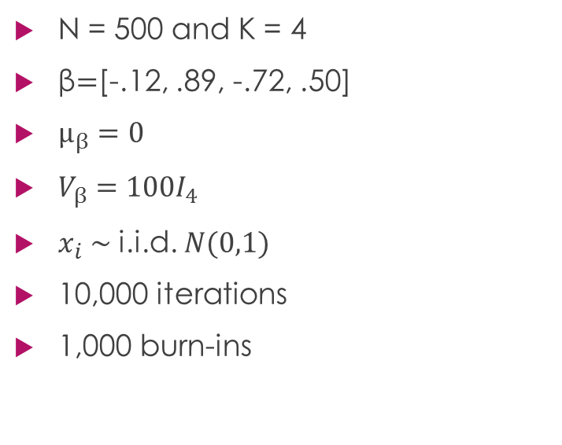
Simulation Data
N = 500 and K = 4
β$=$[-.12, .89, -.72, .50]
$µ_{β}=0$
$V_{β}={100I}_{4}$
$x_{i} \sim$ i.i.d. $N(0,1)$
10,000 iterations
1,000 burn-ins
True Beta | Estimated | Std. Dev.
-.12 | -0.2001601 | 0.06963436
.89 | 0.95519733 | 0.08798751
-.72 | -0.68971489 | 0.07942056
.50 | 0.41907307 | 0.07524416

Slide 7
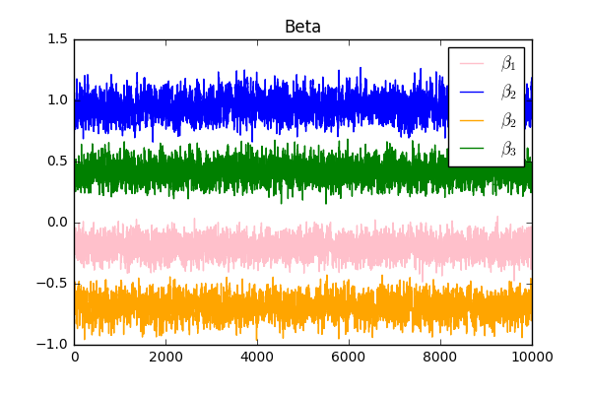
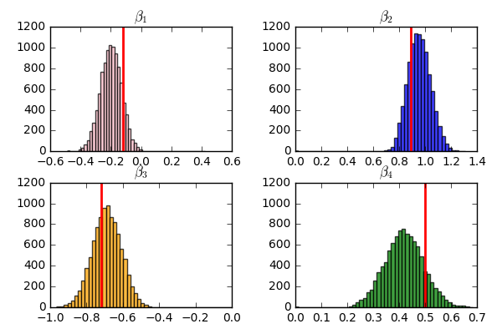
Estimated Parameters

Slide 8
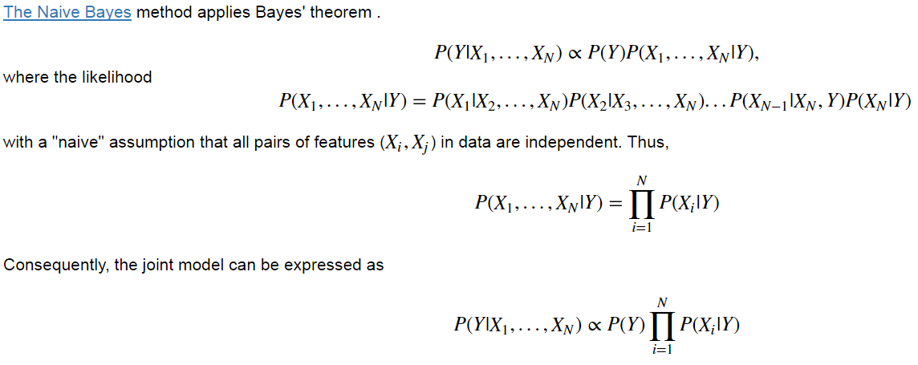
Naïve Bayes

Slide 9
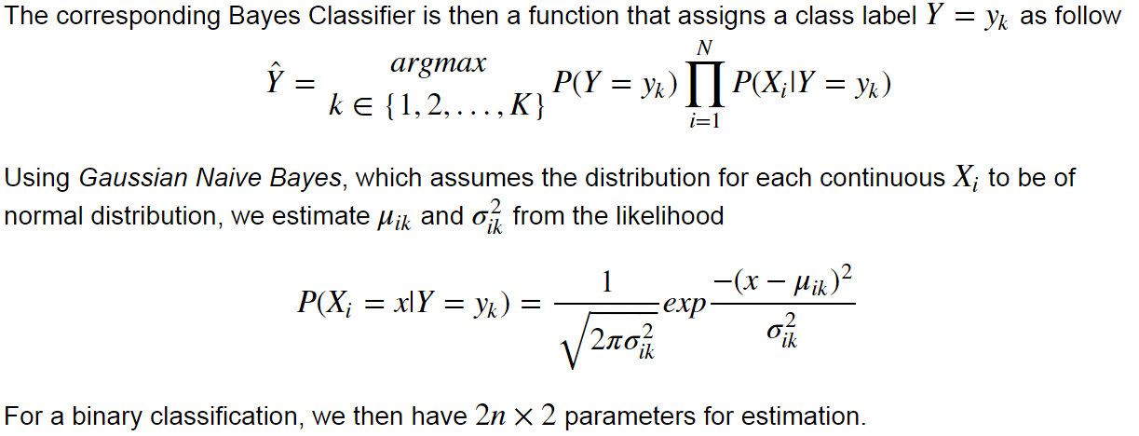
Naïve Bayes (cont.)

Slide 10
PROBIT MODEL (MCMC) * Accuracy: 76% * F1-score: 0.7391
Simulated Data
Naïve Bayes
Accuracy: 72%
F1-score: 0.7021

Slide 11
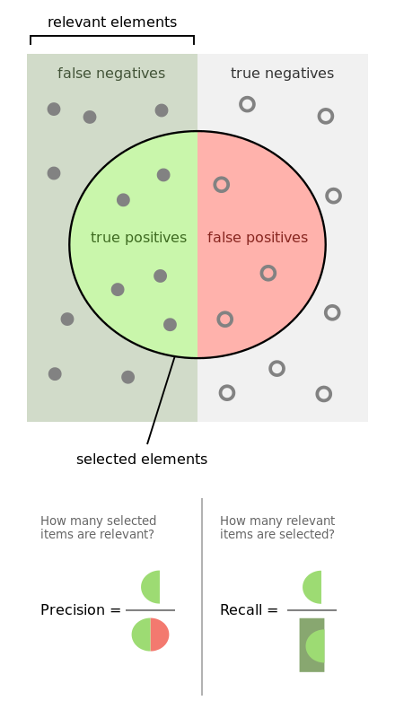
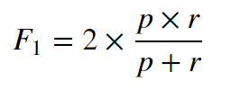
Accuracy = (TP+TN)/Population F1-score

Slide 12
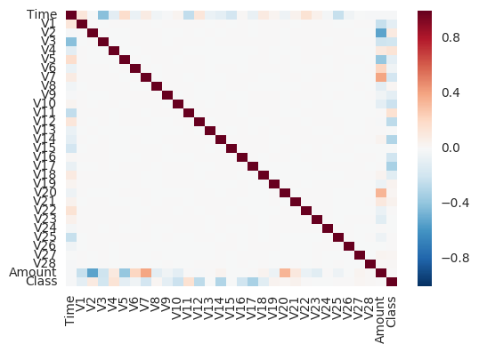
Naïve Bayes modeling
Naïve Bayes
Normal Distribution
Assumption
Independence
Random Data Splitting

Slide 13
PROBIT MODEL (MCMC) * F1-score: 0.5156 * F1-score [Bootstrap]: 0.558
Credit Card Data
Naïve Bayes
* F1-score: .095
* F1-score [Bootstrap]: 0.1228

Slide 14
CONCLUSION
Data: credit card transactions
Methods: Probit Model (MCMC) & Naïve Bayes
F1-score & bootstraping
Probit Model performs better on this dataset.
Questions???

